Slide 1


Exception Handling w/ Try-Catch
Demo Lesson
Dr. Michael Robbeloth
12/3/2024

Slide 2
Imagine a World Before Exceptions
What would it be like?
Let’s see the code?

Slide 3
Why Use Exceptions?
To anticipate that a method call might fail (be proactive!)
To provide customized handling of an error
Interrupt the normal flow of program execution
Move the processing elsewhere (pass the buck)
Better classify the errors (do something better than error codes).
An exception is an
exceptional event!
Notes:
On #4, separate the details of processing an error from the normal program flow.
On #4, move errors up the call stack to a better location for processing
On #5 Be specific (FileNotFoundError) or generalize the errors (IOException) based on needs
Being more specific allows for a better error handling strategy

Slide 4
When?
Establishing a network connection
Reading from a file
Resource is not found
Permissions are missing or incorrect (security events)
Programmer defined standard workflow breaks down, something exception happens

Slide 5
What does the Exception object contain?
Type of error
State of program (call stack)
Notes:
Does everyone know what the call stack is?
The set of methods that have been called that led us to the error that the program has encountered.

Slide 6
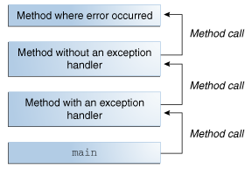
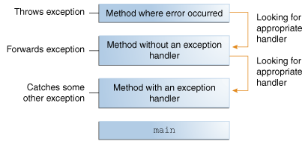
Who has to deal with the Exception?
Runtime system tries to find a runtime handler
A method has to provide a special block of code to process that exception
The buck keeps getting passed until that special block is found
No special block found; the program gets terminated

Slide 7
Basic Syntax
try { // some awesome code here
…
// some code that calls a method that might generate an exception
method()
catch(SomeException|SomeException2 se) {
// process SomeException or its descendent exception here
// could even rethrow the exception after handling to higher block
}
finally {
// clean up code regardless of normal or exceptional operation
// may not get here w/ exit() or abnormal termination in try-catch
}
Notes:
There is an alternative try w/ resources try (FileWriter f = new FileWriter("OutFile.txt"); PrinterWriter out = new PrinterWriter(f); ");
Resources will be closed w/o need for finally block
Anything that uses AutoCloseable interface

Slide 8
Types of Exceptions
Checked Exceptions (Anticipate and Recover)
Errors (Hardware Malfunctions, Resource Exhaustion,Bugs)
Throwable → Error → VirtualMachineError → …
OutofMemory easy to do
StackOverFlow easy to do
InternalError/UnknownError requires finding something broke in the JVM
Throwable → Error → AssertionError
Unchecked Exceptions (Runtime Errors)
Notes:
Let’s move to the code to example each of the example and practice writing some code of our own.
Runtime errors can be caught if desired, but can often represent a nonrecoverable state

Slide 9
So Why Bother with Checked Exceptions?
Why not just use unchecked exceptions?
Why not just inherit checked exception classes and throw RuntimeException (see UglyException) to avoid any real work?
Avoid specifying or catching errors and make the code more streamlined
Part of the API like each method’s programming signature, you are responsible for it.
Things you want the client to handle, make it checked

Slide 10
Review Quiz
Notes:
https://create.kahoot.it/details/a9d9fe6e-f582-4503-9a8b-9a17d546a587
Robbeloth.1

